Slide 1


Information Technology Test
Teamwork Project C#
Team
Vladimir Nabokov

Slide 2

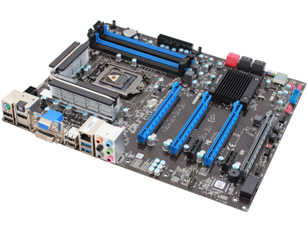
Computer systems
Hardware

Slide 3
Question
Which of the following is NOT a type of RAM?
DRAM
ERAM
SRAM
SDRAM

Slide 4
Answer
There is no such thing as ERAM when it comes to random access memory. Instead, there is:
StaticRAM (SRAM)
DynamicRAM (DRAM)
Synchronous DynamicRAM (SDRAM)
Information:
http://en.wikipedia.org/wiki/Random-access_memory

Slide 5



Software Systems
Computer software

Slide 6
Question
Which are the two main programming language paradigms used to produce a computer program?
imperative and declarative
impulsive and declarative
impulsive and decisive
declarative and executable

Slide 7
Answer
Imperative – program consists of number of commands, which dictate what and in what order the computer should do
Declarative – expresses logic behind the process without describing command order
Information:
http://en.wikipedia.org/wiki/Computer_program

Slide 8



Working with computer programs and systems
Installation, usage, support

Slide 9
Question
What does the abbreviation PAE stand for?
Physical Address Extension
Portable Application Engine
Player Available Extra
Private Address Eraser

Slide 10
Answer
In computing, Physical Address Extension (PAE) is a feature to allow 32-bit x86 central processing units (CPUs) to access a physical address space (e.g., RAM) larger than 4 gigabytes
Information:
http://en.wikipedia.org/wiki/Physical_Address_Extension

Slide 11


Data transfer and Numeric systems
Means of data transfers, measurement units, work with numeric systems

Slide 12
Question
How do you compare the speeds of SSD and RAM?
SSD is two times faster than RAM
RAM is two times faster than SSD
SSD is many times faster than RAM
RAM is many times faster than SSD

Slide 13
Answer
SSD runs at speeds from 200 MB/s and to 500 MB/s, while RAM runs at speeds from 6400 MB/s to 17066 2/3 MB/s
Information:
RAM: http://en.wikipedia.org/wiki/DDR3_SDRAM http://en.wikipedia.org/wiki/Random-access_memory
SSD: http://en.wikipedia.org/wiki/Ssd
SSD compared to HDD: http://www.storagereview.com/ssd_vs_hdd

Slide 14















Operating systems
Architecture, processes, users, user interface, file systems

Slide 15
Question
What is kernel?
Specific part of Linux operating system
Specific part of Microsoft operating system
Specific part of MAC operating system
All of the above

Slide 16
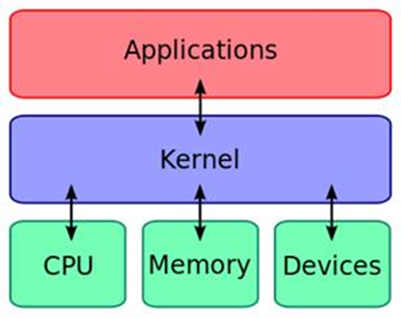
Answer
In computing, the kernel is a computer program that manages input/output requests from software and translates them into data processing instructions for the central processing unit and other electronic components of a computer. The kernel is a fundamental part of a modern computer's operating system
Information:
http://en.wikipedia.org/wiki/Kernel_(computing)

Slide 17

Software engineering
Analysis, specification, projection, prototype, implementation, testing, support

Slide 18
Question
Which of the following is NOT one of the 12 guiding principles in Agile software development?
Deliver working software frequently, from couple of weeks to a couple of months
Working software is the primary measure of progress
The best architectures, requirements, and designs emerge from self-organizing teams
Created software is always open-source and is distributed under GPL V2 license
All of the above
None of the above

Slide 19
Answer
Agile development is a phrase used in software development to describe methodologies for incremental software development. Agile development is an alternative to traditional project management where emphasis is placed on empowering people to collaborate and make team decisions in addition to continuous planning, testing and integration
Information:
The 12 Principles: http://www.agilemanifesto.org/principles.html
More on Agile: http://en.wikipedia.org/wiki/Agile_software_development

Slide 20









Data Compression
Algorithms for compression, archiving software

Slide 21
Question
The .xz file format is:
Archiving only
Compression only
Archiving and compression
Software packaging and distribution
Document packaging and distribution

Slide 22
Answer
The .xz file format is used to compress single files as input, and does not bundle multiple files into a single archive. It is therefore common to compress a file that is itself an archive
Information:
http://en.wikipedia.org/wiki/Xz

Slide 23



Text processing
Working with word processing software, file formats, coding, text, tables, figures

Slide 24
Question
Which of the word processors is an open source program?
AbiWord
Kingsoft Writer
Mellel
WordPad

Slide 25
Answer
AbiWord is an open source software word processor, which runs on Linux, Microsoft Windows and other operating systems
Information:
http://en.wikipedia.org/wiki/AbiWord

Slide 26
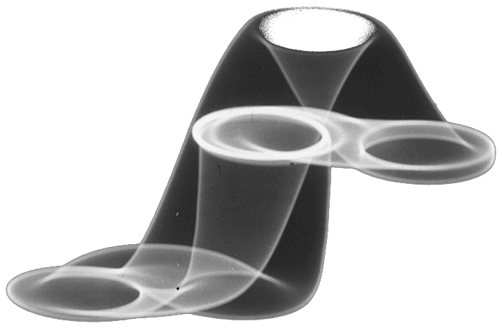



Computer graphics
Raster and vector graphic, image formats, image editors, color ranges

Slide 27
Question
What does Tessellation do in computer graphics?
Decreases the quality of rendering in-game
Decreases the organization of information needed to render
Gives the appearance of the surfaces of realistic three-dimensional objects
Makes the 3d water look better

Slide 28
Answer
In computer graphics, the term "tessellation" is used to describe the organization of information needed to render and to give the appearance of the surfaces of realistic three-dimensional objects
Information
http://en.wikipedia.org/wiki/Tessellation
http://cryengine.com/features/visuals

Slide 29






Databases
Data models, tables, relationships, SQL

Slide 30
Question
Which of the following statements can be used to display all rows from MySQL table “books”?
SELECT * FROM books
SHOW * FROM books
DISPLAY * FROM books
SELECT ALL * FROM books
DISPLAY ALL* FROM books

Slide 31
Answer
A SELECT statement retrieves zero or more rows from one or more database tables or database views
Information:
http://www.w3schools.com/sql/

Slide 32

Information systems
ERP, CRM, BI, BPM, FMIS, CAD/CAM, CMS,
software architectures

Slide 33
Question
What does the FAIS abbreviation stand for?
First Assignment Information Systems
Functional Assessment Information Systems
Functional Area information Systems
First Aid Information Systems

Slide 34
Answer
The functional area information systems (FAIS) are supporting pillars for more general information systems – for example, business intelligence systems
Information:
http://en.wikipedia.org/wiki/Information_systems

Slide 35


Security and data protection
Symmetrical and asymmetrical coding algorithms, cryptographic hash, digital signature, digital certificates

Slide 36
Question
What is the recommended way to escape MySQL injections in PHP?
Use the function mysqli_real_escape_string
Use the function mysql_real_escape_string
Use https
All of the above

Slide 37
Answer
mysql_ - functions are no longer supported
mysqli_ - the new rewritten functions, which are more secure
Information:
http://www.php.net/manual/en/mysqli.real-escape-string.php

Slide 38




Presentation systems
Presentation software, presentation making, slides, effects, colors, images, audio, video

Slide 39
Question
Which of the following is NOT a presentation software?
Google Docs
Prezi
SlideRocket
OpenOffice Impress
None of the above

Slide 40
Answer
SlideRocket – software for online slideshow presentations
Prezi – cloud based presentation software
OpenOffice Impress – multimedia presentation tool
Google Docs – online presentation tool
Information:
http://en.wikipedia.org/wiki/Presentation_program

Slide 41

Multimedia
Software for creation / processing media: audio, video, file formats

Slide 42
Question
Linear multimedia active content progress:
Cannot be navigated by the viewer
Can always be navigated by the viewer
Can be navigated by the viewer only if the program allows it
Is commonly known as “Hypermedia”
Is widely used in video games

Slide 43
Answer
Multimedia may be broadly divided into linear and non-linear categories. Linear active content progresses often without any navigational control for the viewer such as a cinema presentation. Non-linear uses interactivity to control progress as with a video game or computer-based training. Hypermedia is an example of non-linear content
Information:
http://en.wikipedia.org/wiki/Multimedia

Slide 44
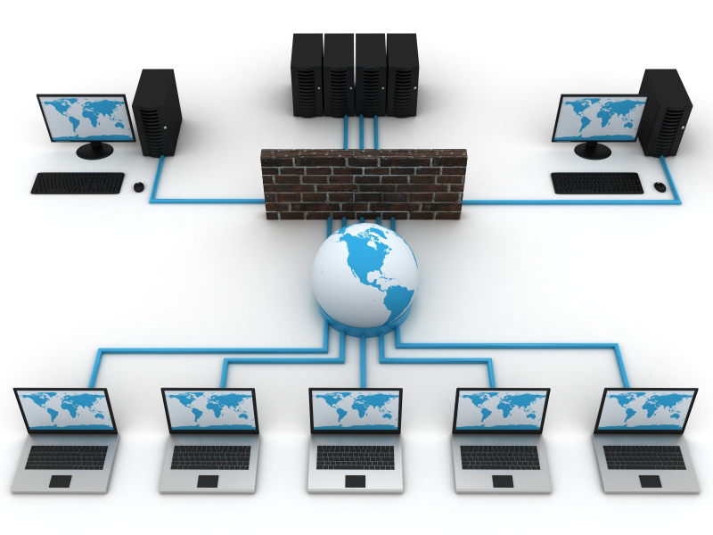
Computer Networks
OSI model, network models, protocols, standards, hardware

Slide 45

Question
What kind of topology is displayed in the diagram?
Mesh
Star
Bus
Tree
Ring

Slide 46
Answer
Mesh
All devices are interconnected
Guarantees communication between devices, even if some of the connections break down
Expensive installation
Information:
http://en.wikipedia.org/wiki/OSI_model

Slide 47

Internet
Internet, protocols, services, WWW, HTTP, FTP, SMTP, POP3, IMAP, WebDAV, IP, DNS

Slide 48
Question
What is the other name of IPng?
IPv6
IPenp
IPv4
IETF

Slide 49
Answer
IPv6 (Internet Protocol Version 6) is also called IPng (Internet Protocol next generation) and it is the newest version of the Internet Protocol (IP) reviewed in the IETF standards committees to replace the current version of IPv4 (Internet Protocol Version 4)
Information:
http://en.wikipedia.org/wiki/IPv6
http://en.wikipedia.org/wiki/IPv4
http://en.wikipedia.org/wiki/IETF

Slide 50

Electronic communication
E-mail, Skype, ICQ, IRC, MSN Messenger, Yahoo Messenger, social networks, forums

Slide 51
Question
In what format does Microsoft Office Express save emails?
eml
emlx
msg
mbx

Slide 52
Answer
MSG files are Outlook messages saved as files
They are saved as "COM structured storage OLE2 compound documents" or "DocFile", which is the same technique used by Word, Excel and many more
Information:
http://msdn.microsoft.com/en-us/library/cc463912(v=exchg.80).aspx

Slide 53

World Wide Web (WWW)
How does WWW work? Protocol HTTP, GET, POST, URL, web browser, web page, web site

Slide 54
Question
Who is listening to my computer’s HTTP request on port 80?
The Domain Name System (DNS)
The computer receiving the request
The web server software
The NSA

Slide 55
Answer
The computer receiving the HTTP request delivers it to web server software listening for requests on port 80. If the web server can fulfill the request, it sends a response back to the browser indicating success
Information:
http://en.wikipedia.org/wiki/World_Wide_Web

Slide 56


Web design, HTML, CSS
Web design, HTML, CSS, text, graphics, references, tables, forms

Slide 57
Question
Which of the following CSS source types has the highest priority?
Selector specificity
Rule order
Media type
User definition
Inline

Slide 58
Answer
Most browsers have the accessibility feature of a user defined CSS. This feature is the style sheet with highest priority and controls the content display
Information:
http://en.wikipedia.org/wiki/CSS

Slide 59





JavaScript
Script development with JavaScript, basic JavaScript constructions, operators, objects, manipulation of DOM tree

Slide 60
Question
In an HTML document, where can you embed JavaScript code?
Between the <head></head> tags
Between the <body></body> tags
A) and B)
It can only be inserted between the <head></head> tags, through external .js file

Slide 61
Answer
Answer D) is only partially right, because a link to an external file can be added between the <head></head> tags and later used in the body of the html document. The answer, however, says “only” which makes it wrong
Information:
http://www.w3schools.com/js/
http://en.wikipedia.org/wiki/JavaScript

Slide 62

?
?
?
Questions
?
?
?

